Slide 1
Smart Building
Paolo Barsocchi –WNLab

Slide 2

Riassumendo

Slide 3






Dove ci eravamo lasciati

Slide 4
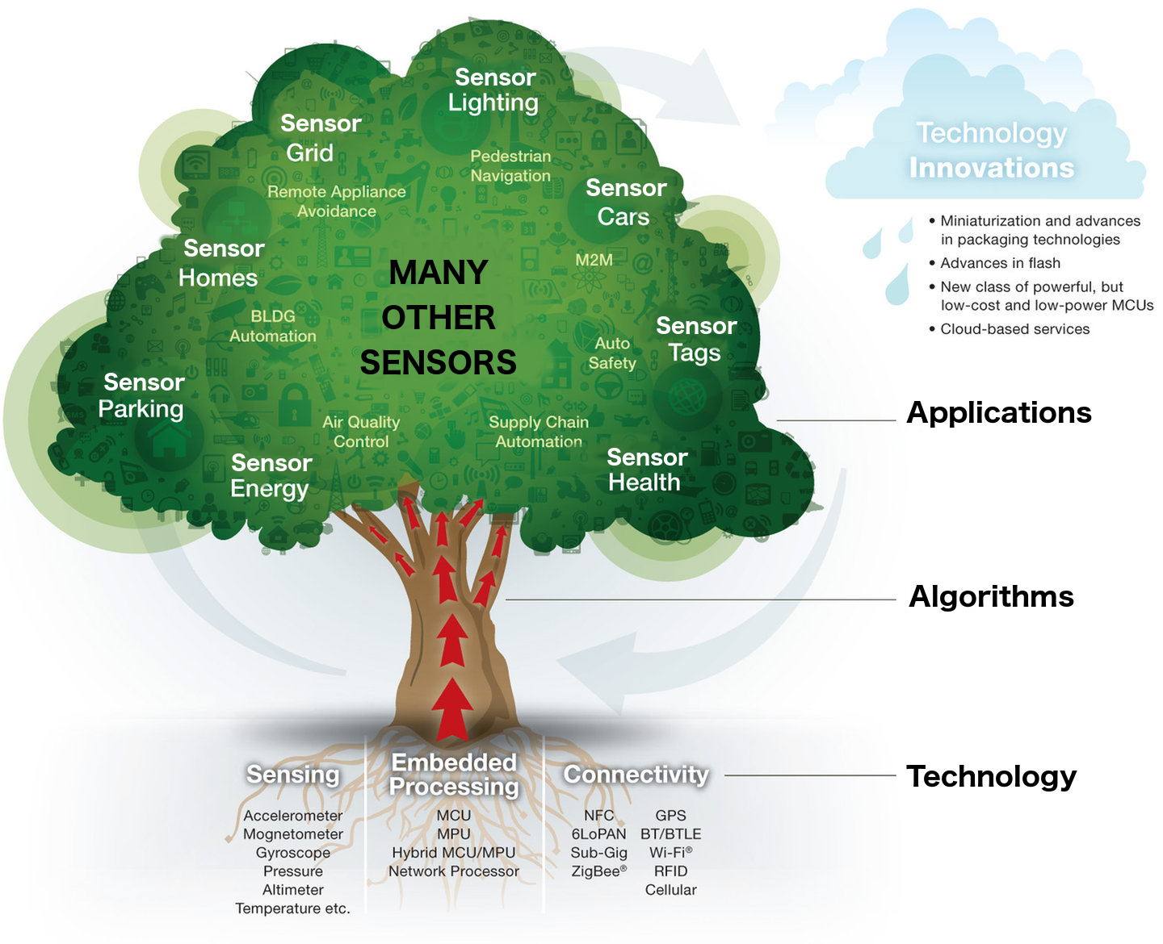
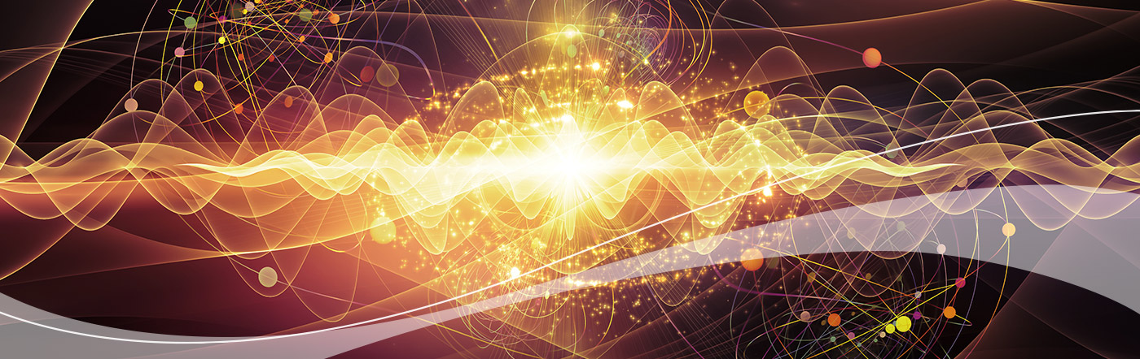
Sensori Virtuali
Un sensore virtuale usa le informazioni provenienti da altre misure per stimare la quantità di interesse.
  Benessere
  Spreco energetico
  Intrusione / Occupazione

Slide 5
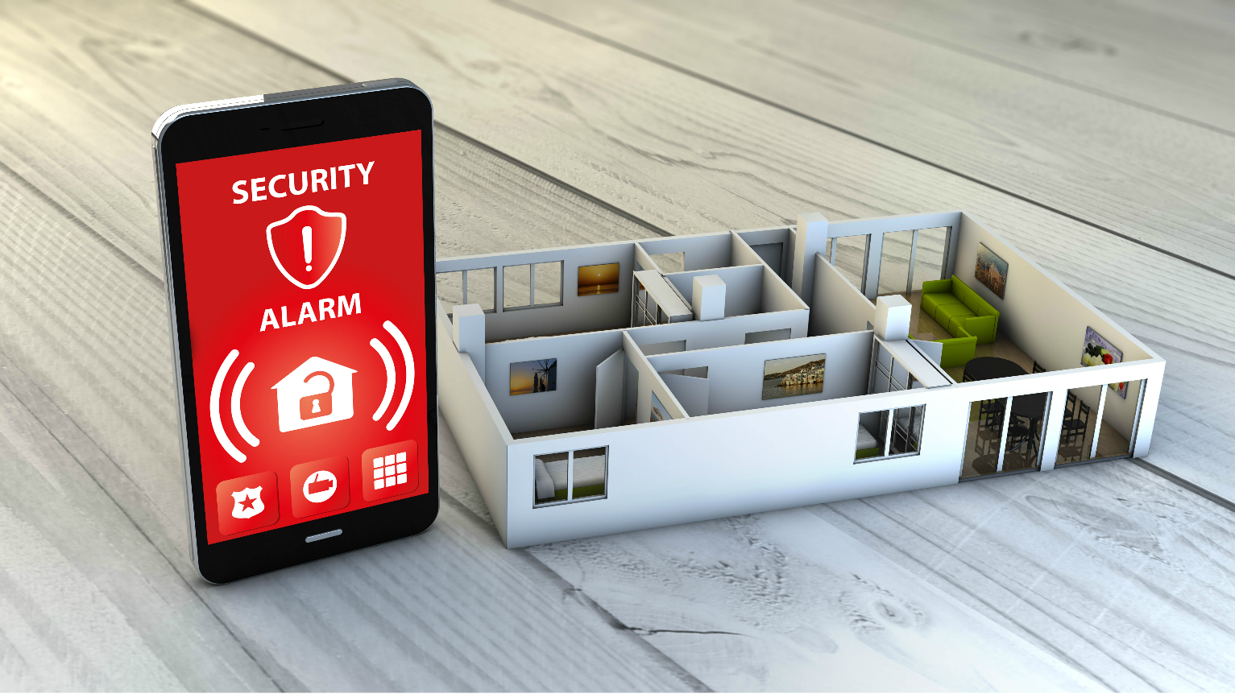

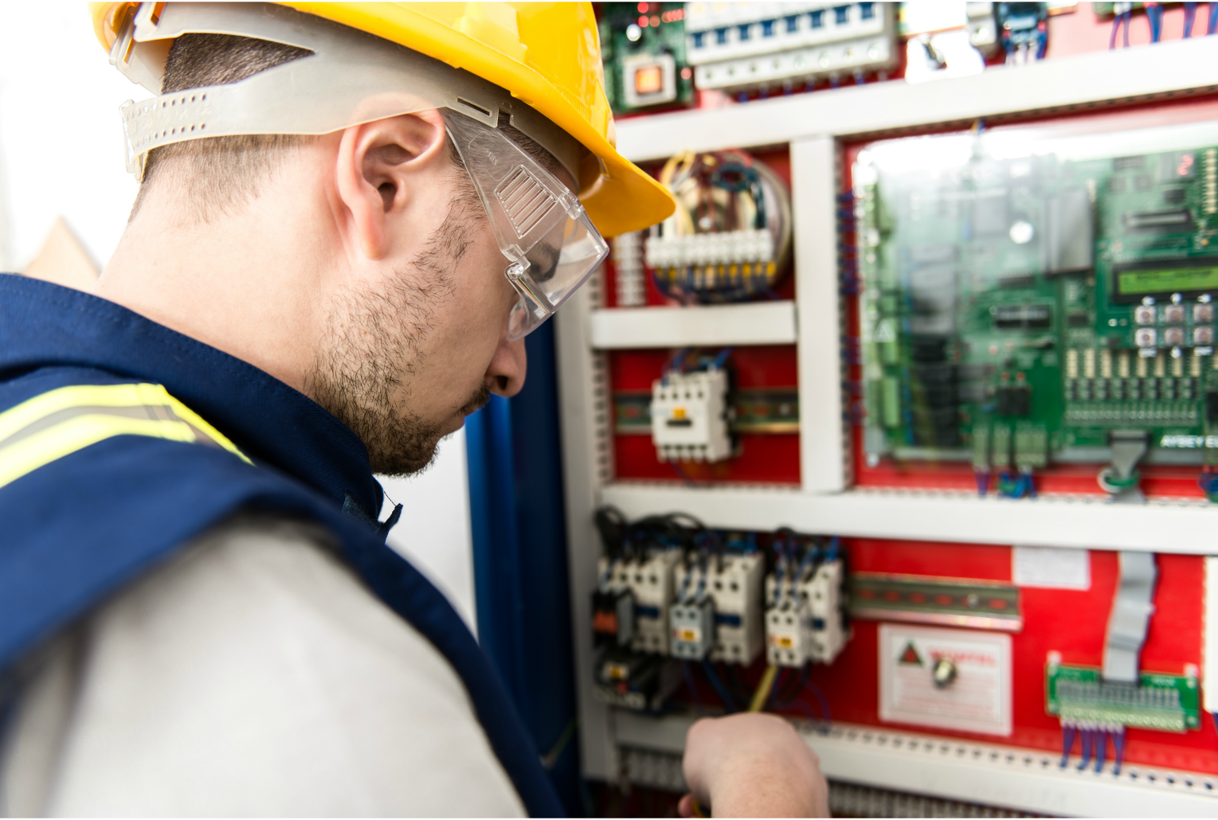
Scenari Applicativi

Slide 6

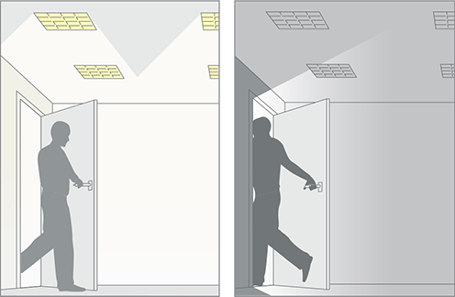


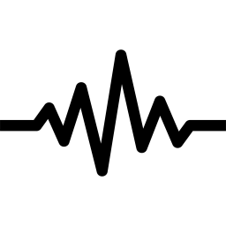


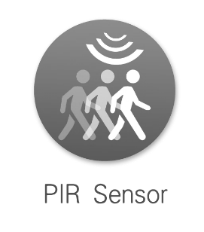
Presence detection
Notes:
Descrivere che lo possiamo fare con tecnologia differente
Ogni tenologia ha i suoi pro e I suoi contro
Sensori Ambientali → non identifica la persona, identifica bene l’ingresso ma non altrettanto l’uscita
Sensoristica indossabile → identifica la persona, la calibrazione dei parametri degli algoritmi devono essere calibrati sulla persona e sull’ambiente
Immagini video → identifica la persona, non riconosco una persona (scarsa luminosità, movimenti veloci della persona)
Fusione dei dati → la migliore ma implica sensorizzare l’ambiente e la persona in maniera invasiva

Slide 7
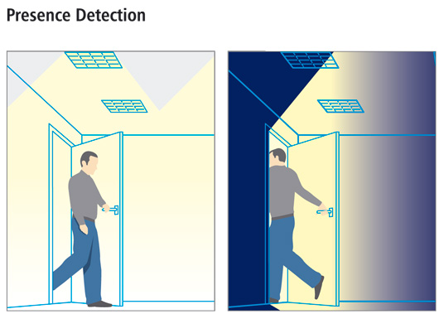
Sensoristica Ambientale
Notes:
How to detect the presence or the absence of a person in an office information gathered from sensing units such as : power consumption, noise detect and PIR sensor. All such data are continoiusly gathered and send to a cloud system. Our algorithm crunches them and gives us a feedback.
We propose a long-term monitoring service designed for offices, with the goal of measuring a number of environmental parameters and to store them to a cloud infrastructure. Data collected in the cloud are analyzed in order to detect automatically the presence or the absence of an employee within its office and, in turn,
To automatically perform energy saving actions
To understand human behavior in working environments

Slide 8
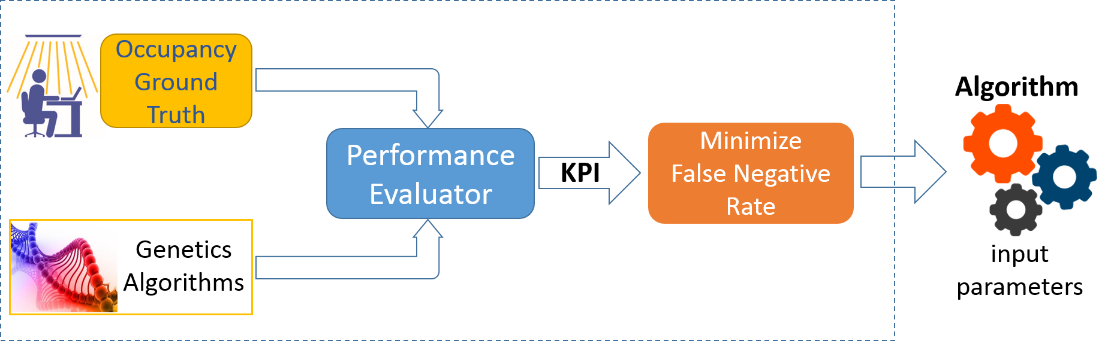
Osservazione

Slide 9

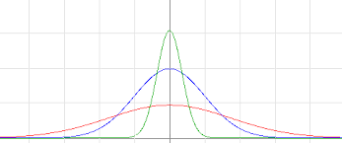
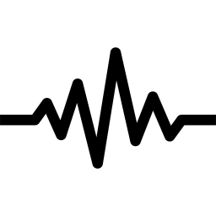
Algoritmo
P
N
S
Time

Slide 10
Stima dei Parametri

Slide 11
Prestazioni

Slide 12
Prestazioni
95% accuracy

Slide 13
Sensoristica Indossabile
Notes:
How to detect the presence or the absence of a person in an office information gathered from sensing units such as : power consumption, noise detect and PIR sensor. All such data are continoiusly gathered and send to a cloud system. Our algorithm crunches them and gives us a feedback.
We propose a long-term monitoring service designed for offices, with the goal of measuring a number of environmental parameters and to store them to a cloud infrastructure. Data collected in the cloud are analyzed in order to detect automatically the presence or the absence of an employee within its office and, in turn,
To automatically perform energy saving actions
To understand human behavior in working environments

Slide 14
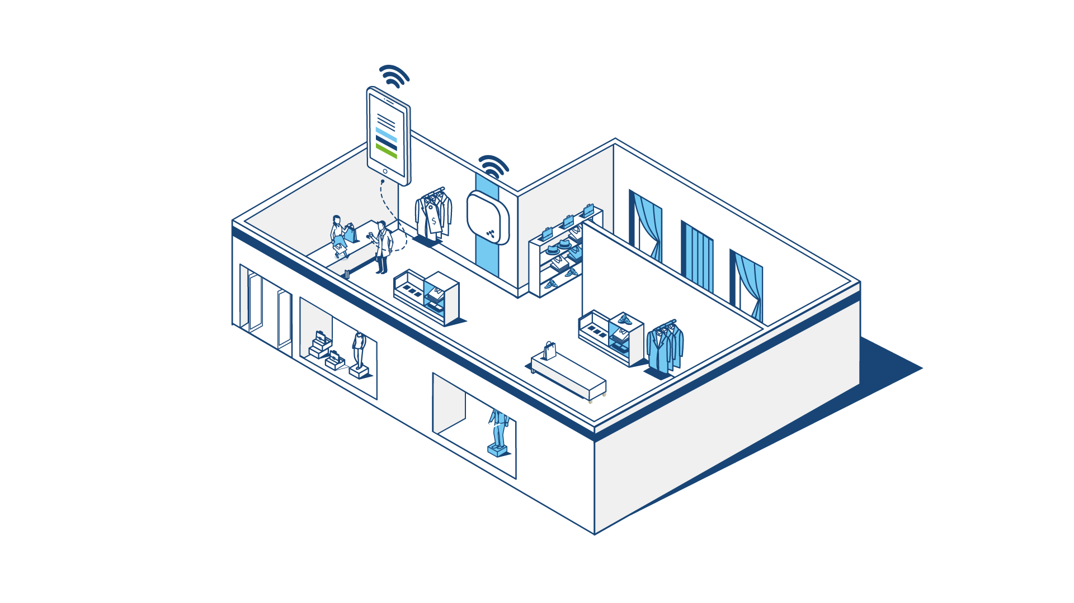
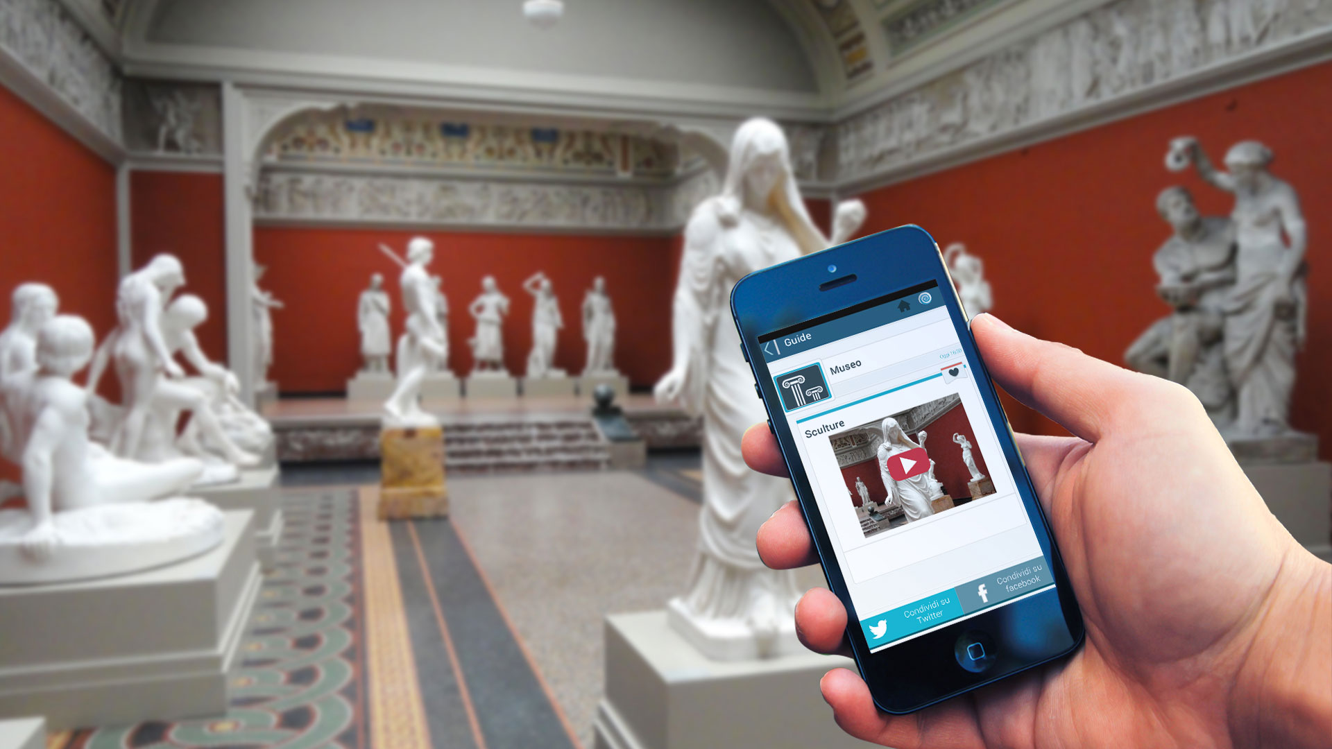
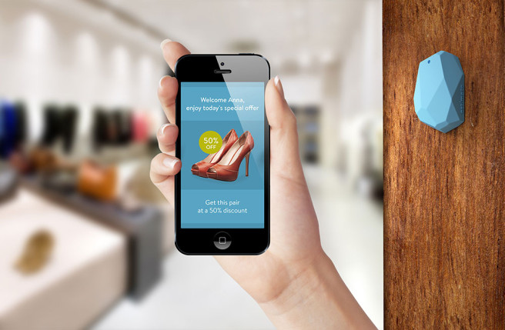
Che cosa sono i beacon

Slide 15
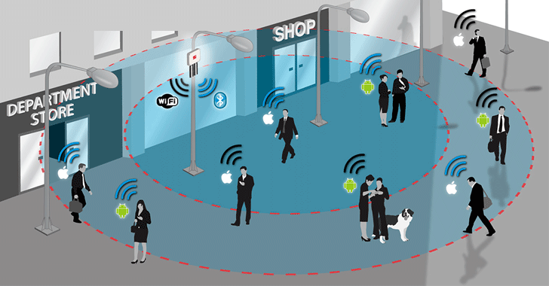
Come li abbiamo usati

Slide 16
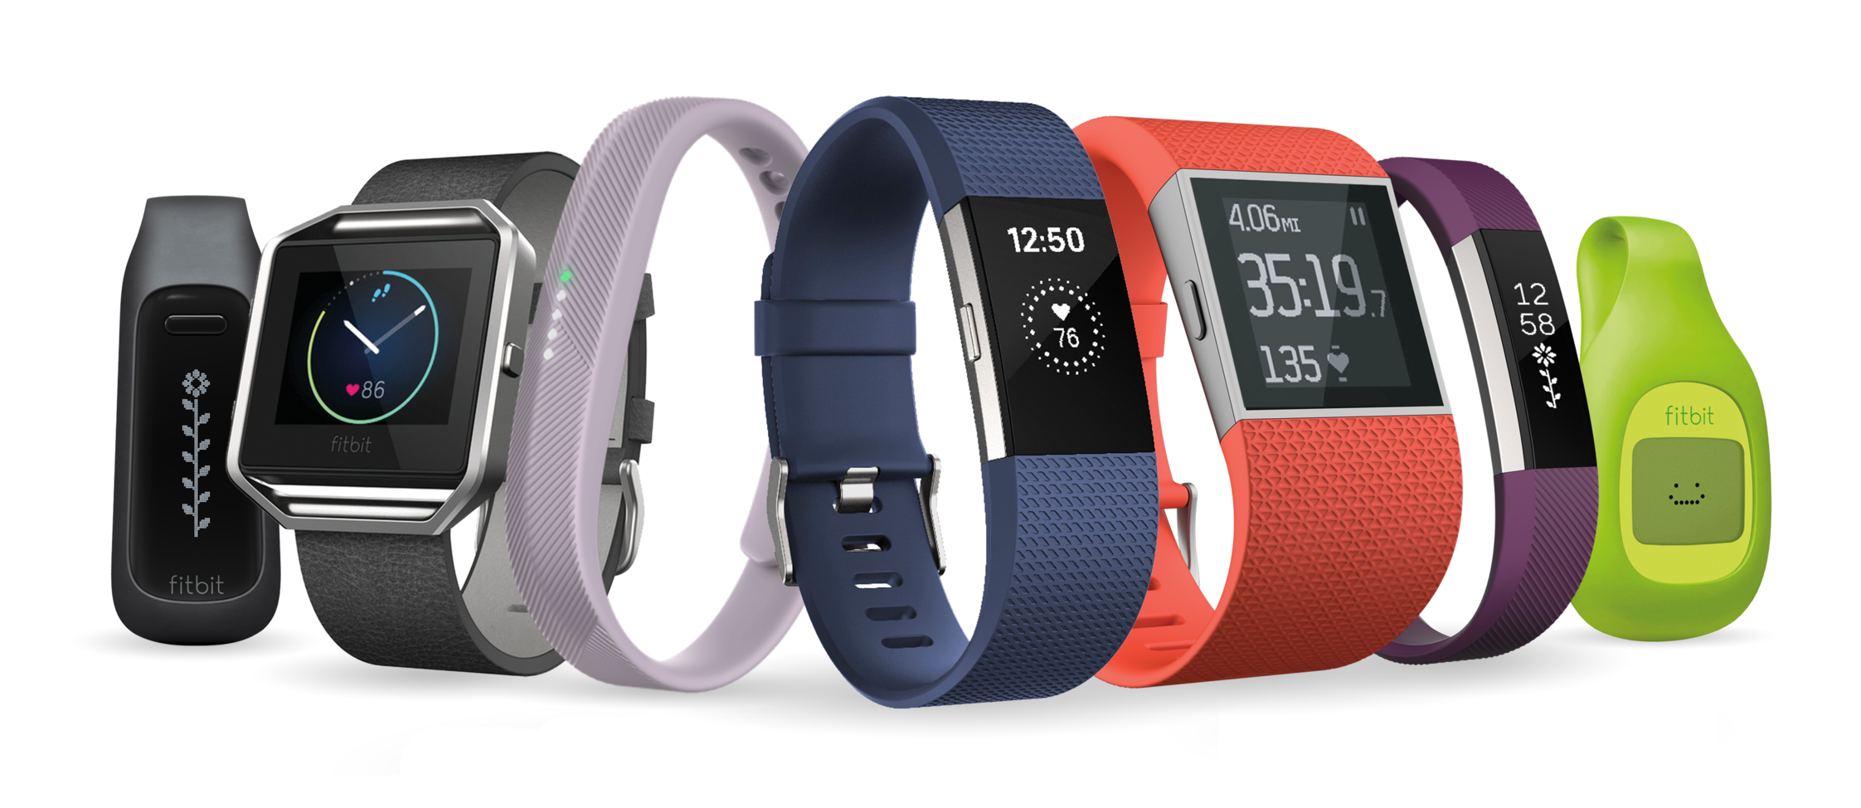
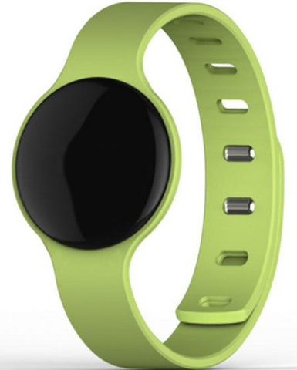
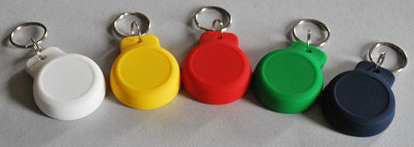
Cosa abbiamo usato

Slide 17
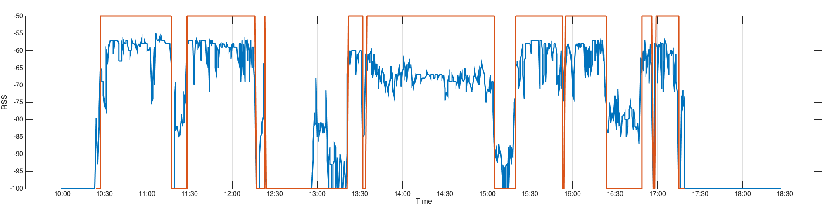
Osservazione
Stessi valori di potenza

Slide 18
Prestazioni
98% accuracy ricevitore in ogni stanza

